Slide 1

Chapter 5
Serving Static Files

Slide 2

Objectives
Django includes tools to reference static files in templates and you'll see how these tools help reduce the amount of work needed when deploying an application to production.
Explore the findstatic command, which can be used to debug issues with your static files.

Slide 3
Static File Serving
A URL mapping to the static view is automatically set up when running the Django development server, provided that your settings.py file meets the following conditions.
Has DEBUG set to True
Contains 'django.contrib.staticfiles' in its INSTALLED_APPS

Slide 4
Static File Serving
The URL mapping that is created is roughly equivalent to having the following map in your urlpatterns:

Slide 5
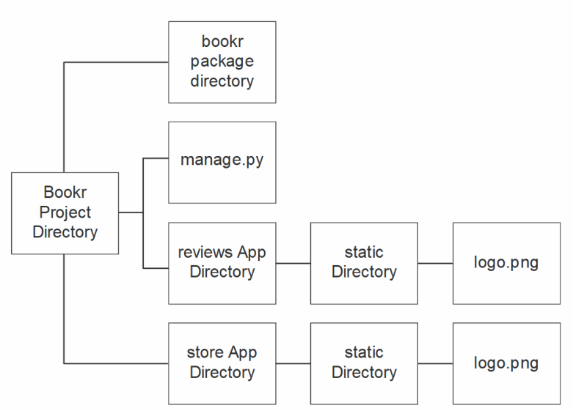
Static File Namespacing
Directory layout with static directories inside app directories.

Slide 6

Generating Static URLs with the static Template Tag
To display the image with an img tag, you could use this code in your template:
Django is also serving the media and has the same host as the dynamic template response.

Slide 7


Generating Static URLs with the static Template Tag
Django uses /static/ as STATIC_URL. If we wanted to generate the static URL for our logo.png file, we would use the tag in a template like this:
The output inside the template would be this:

Slide 8
File System Finder
We can use the BASE_DIR setting when building the list to assign to STATICFILES_DIRS.
Simply add extra directories to the STATICFILES_DIRS list:

Slide 9
Static File Finders: Use During collectstatic
Assume that STATIC_ROOT is set to a directory being served by a normal web server – this would be something like /var/www/business_site/static.

Slide 10
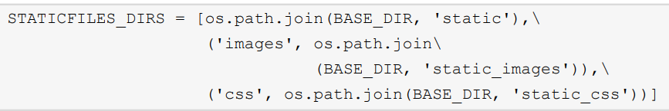
STATICFILES_DIRS Prefixed Mode
As mentioned earlier, the STATICFILES_DIRS setting also accepts items as tuples in the form (prefix, directory).

Slide 11
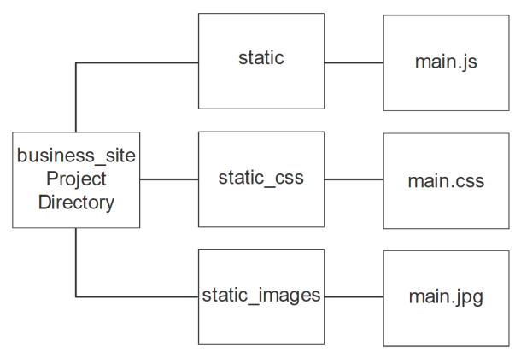
STATICFILES_DIRS Prefixed Mode
Directories layout for use with prefixed URLs.

Slide 12
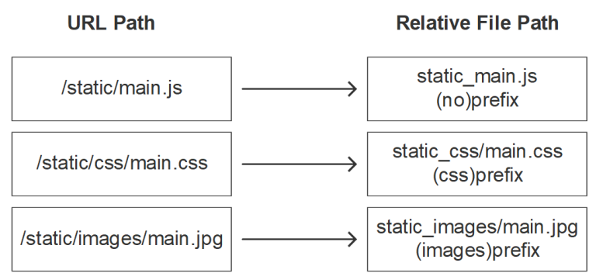
STATICFILES_DIRS Prefixed Mode
Mappings of URLs to files, based on the prefix.

Slide 13
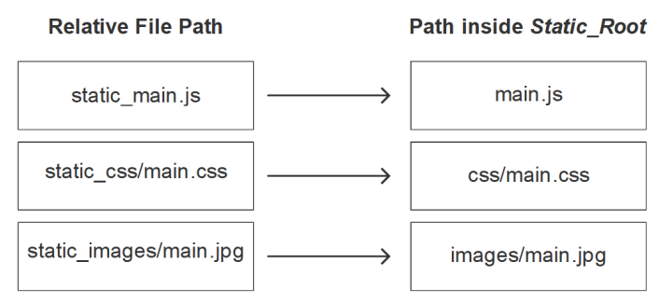
STATICFILES_DIRS Prefixed Mode
Mappings of paths in project directories to paths in STATIC_ROOT.

Slide 14
Summary
In this chapter, we showed how to use Django's staticfiles app to find and serve static files.
Showed different places to store static files, using a directory that is global to the project or a specific directory for the application.
Showed the importance of namespacing static file directories to prevent conflicts.

